Slide 1
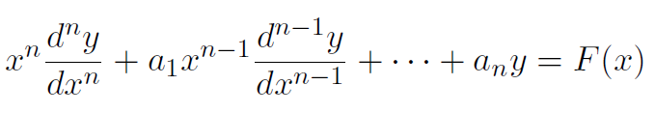
  Linear Diﬀerential Equations with Variable Coeﬃcients
We will now study two types of linear diﬀerential equations with variables coeﬃcients which can be reduced to linear diﬀerential equations with constant coeﬃcients by suitable substitution.
    a. Cauchy’s homogeneous linear equation (Euler type)
An equation of the form
(1)
where a₁, a₂, · · · a_{n} are constants and F (x) is a function of x is called Cauchy’s (Euler’s) homogeneous linear diﬀerential equation. Equation (1) can be transformed to a linear diﬀerential equation with constant coeﬃcients by the transformation

Slide 2
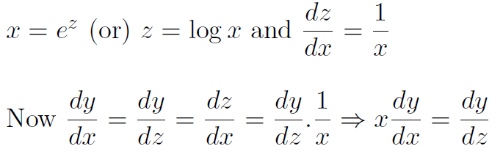
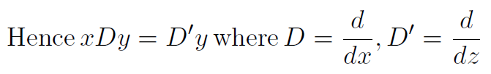
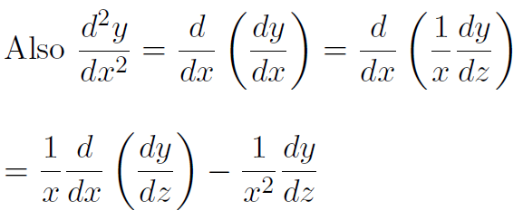
(2)

Slide 3
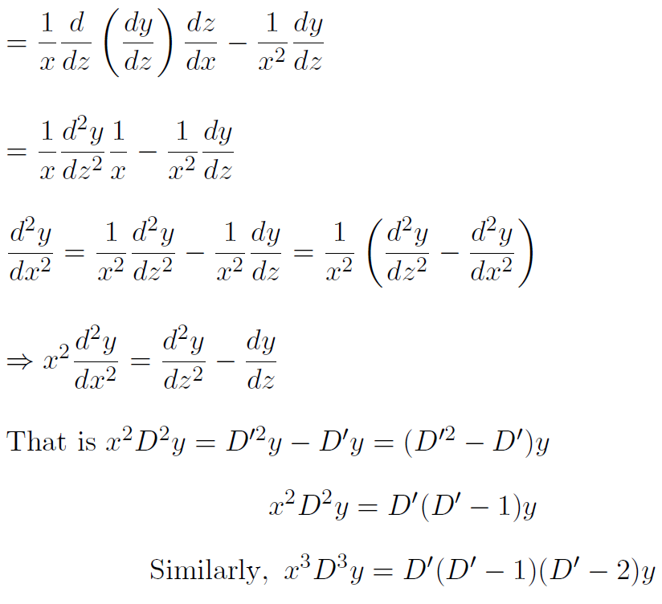
(3)
(4)

Slide 4




Substituting (2), (3), (4) and so on in (1) we get a linear diﬀerential equation with constant coeﬃcients and can be solved by any one of the known method.
Example 1:
Multiplying throughout by x², we have
(i.e.) (x²D² + xD)y = 12 log x (5)
Let x = e^{z} (or) z = log x so that xD = D′, x²D² = D′(D′ − 1),
where

Slide 5
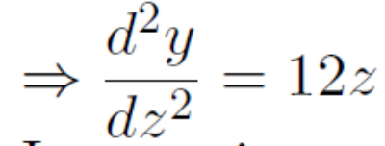
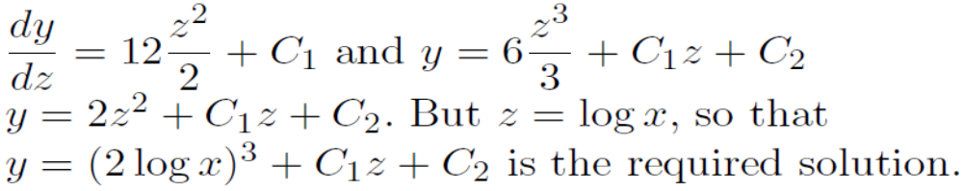
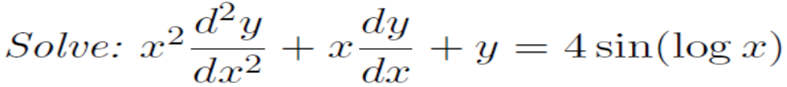
Now equation (5) becomes (D(D′ − 1) + D′)y = 12z (D^{′2} − D′ + D′)y = 12z ⇒ D^{′2}y = 12z
Integrating w. r. to z, we have
Example 2:
Solution:
Given (6)

Slide 6
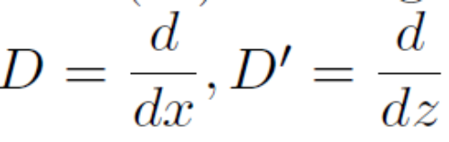
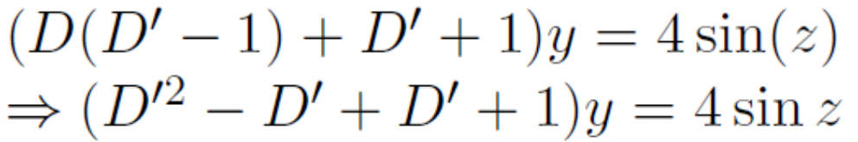
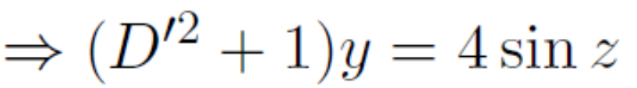
Let x = e^{z} (or) z = log x so that xD = D′, x²D² = D′(D′ − 1),
where
Now equation (6) becomes
(7)
(i.e.) ϕ(D′)y = F (z)
We have to solve equation (7). The auxiliary equation is m² + 1 = 0
⇒ m² = −1 ⇒ m = ±i ⇒ m = 0 ± i = α ± iβ ⇒ α = 0, β = 1
Roots are imaginary.

Slide 7
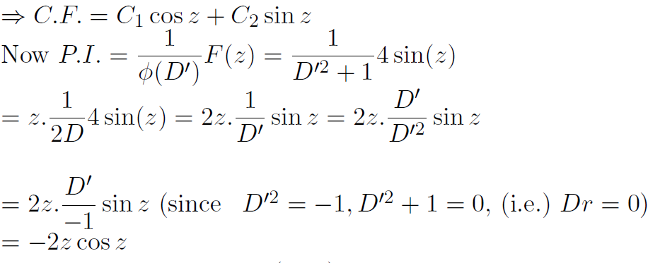
The complete solution of (7) is y = C₁ cos z+C₂ sin z−2z cos z
Then the required solution is
y = C₁ cos(log x) + C₂ sin(log x) − 2(log x) cos(log x)

Slide 8


b. Homogeneous Equations of Legendre’s Type
An equation of the form
(8)
where p₁, p₂, · · · p_{n} are constants, is known as Legendre linear diﬀerential equation.
Equation (8) can be reduced to linear diﬀerential equation with constant coeﬃcients by putting ax + b = e^{z}

Slide 9
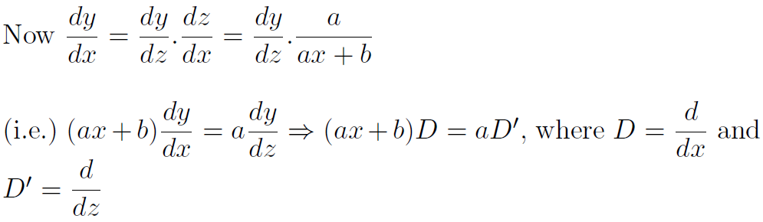
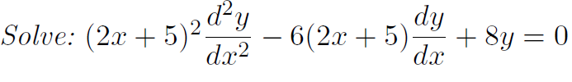

Similarly (ax + b)²D² = a²D′(D′ − 1),
(ax + b)³D³ = a³D′(D′ − 1)(D′ − 2) and so on.
Substituting these in (8), we get a linear diﬀerential equation with constant coeﬃcients which can be solved by any one of the known methods.
Example 1:
Solution:

Slide 10
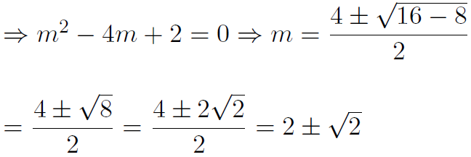
(i.e.) [(2x + 5)²D² − 6(2x + 5)D + 8]y = 0
Let (2x + 5) = e^{z} (or) z = log(2x + 5) so that (2x + 5)D = 2D′
(9)
Now equation (9) becomes
[4D′(D′ − 1) − 6.2D′ + 8]y = 0
[4D^{′2} − 4D′ − 12D′ + 8]y = 0
(i.e.) [4D^{′2} − 16D′ + 8]y = 0
The auxiliary equation of (10) is 4m² − 16m + 8 = 0
(10)

Slide 11



The complete solution of (10) is y = CF + PI.
⇒ The complete solution of (9) is
Example 2:
Solution: Given
(i.e.) [(1 + x)²D² + (1 + x)D + 1]y = 4 cos[log(1 + x)] (11)
Let (1 + x) = e^{z} (or) z = log(1 + x) so that (1 + x)D = 2D′

Slide 12


Now equation (11) becomes
[D′(D′ − 1) + D′ + 1]y = 4 cos z
(i.e.) (D^{′2} + 1)y = 4 cos z
(i.e.) ϕ(D′)y = F (z)
The auxiliary equation of (12) is m² + 1 = 0
⇒ m = ±i = 0 ± i = α ± iβ ⇒ α = 0, β = 1
⇒ C.F. = C₁ cos z + C₂ sin z
Now
(12)
The complete solution of (12) is y = C₁ cos z+C₂ sin z+2z sin z
Hence the complete solution of (11) is
y = C₁ cos[log(1 + x)] + C₂ sin[log(1 + x)]+2[log(1 + x)] sin[log(1 + x)]

Slide 13
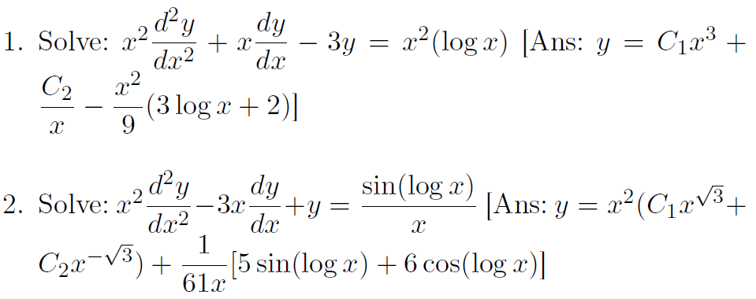
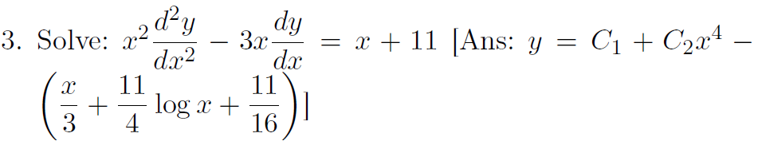
EXERCISE

Slide 14



METHOD OF VARIATION OF PARAMETERS
This method is very useful for ﬁnding the particular integral of a second order linear diﬀerential equation whose complementary function is known.
Consider the equation
(13)
where a₁, a₂ are constants, F (x) is a function of x. Let the com- plementary function of (3.24) is C.F. = C₁f₁ + C₂f₂
where C₁, C₂ are constants and f₁, f₂ are functions of x.
Then PI = Pf₁ + Qf₂
Where
And
(14)
(15)
(16)

Slide 15

Substituting (15) and (16) in (14), we get the PI. Hence the complete solution is y = CF + PI.
Example 1: Solve by the method of variation of parameters.
Solution: Given
(i.e.) (D² + 1)y = sec x
(i.e.) ϕ(D)y = F (x)
The auxiliary equation is m² + 1 = 0 ⇒ m = ±i = 0 ± i
⇒ α ± iβ = 0 ± i ⇒ α = 0, β = 1
⇒ C.F. = C₁ cos x + C₂ sin x = C₁f₁ + C₂f₂
Here f₁ = cos x, f₂ = sin x so that f₁′ = − sin x, f₂′ = cos x
⇒ f₁f₂′ − f₂f₁′ = cos² x + sin² x = 1
Let PI = Pf₁ + Qf₂ = P cos x + Q sin x where

Slide 16
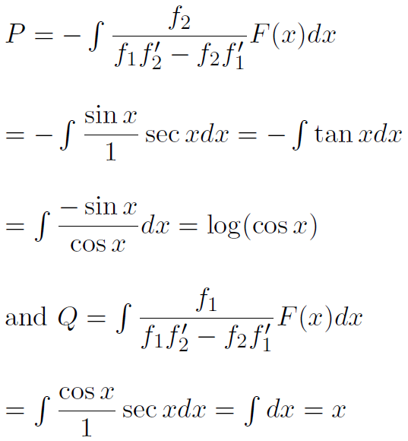
⇒ P.I. = cos x log(cos x) + x sin x
Hence the complete solution is y = CF + PI.
y = C₁ cos x + C₂ sin x + cos x log(cos x) + x sin x

Slide 17

Example 1: Solve using method of
variation of parameters.
Solution: Given
(i.e.) (D² + 4)y = 4 tan 2x
(i.e.) ϕ(D)y = F (x)
The auxiliary equation is m² + 4 = 0 ⇒ m = ±2i = 0 ± 2i
⇒ α ± iβ = 0 ± 2i ⇒ α = 0, β = 2
⇒ C.F. = C₁ cos 2x + C₂ sin 2x = C₁f₁ + C₂f₂
Here f₁ = cos 2x, f₂ = sin 2x
so that f₁′ = −2 sin 2x, f₂′ = 2 cos 2x
⇒ f₁f₂′ − f₂f₁′ = 2 cos² 2x + 2 sin² 2x = 2
Let PI = Pf₁ + Qf₂ where

Slide 18
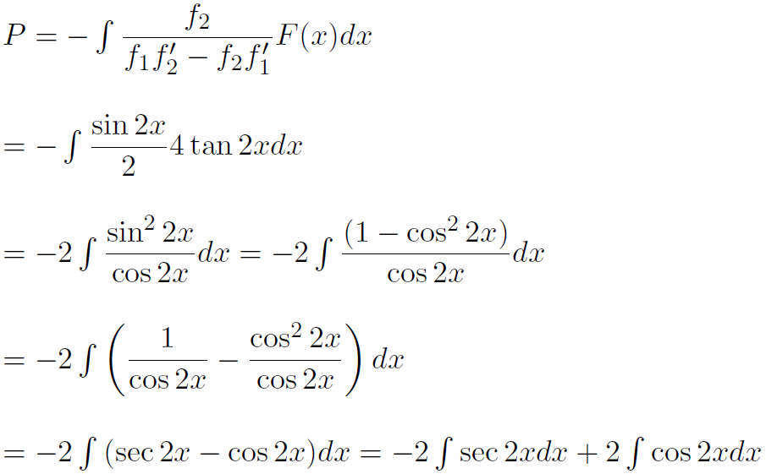
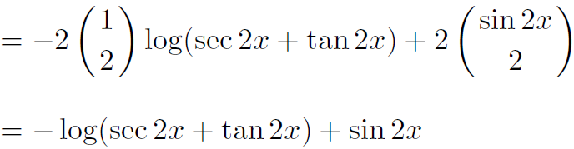

Slide 19
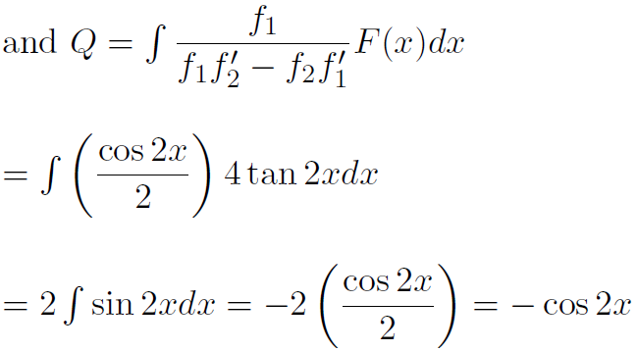
⇒ P.I. = − cos 2x log(sec 2x + tan 2x) + sin 2x cos 2x− sin 2x cos 2x
= − cos 2x log(sec 2x + tan 2x)
Hence the complete solution is y = CF + PI.
y = C₁ cos 2x + C₂ sin 2x − cos 2x log(sec 2x + tan 2x)

Slide 20
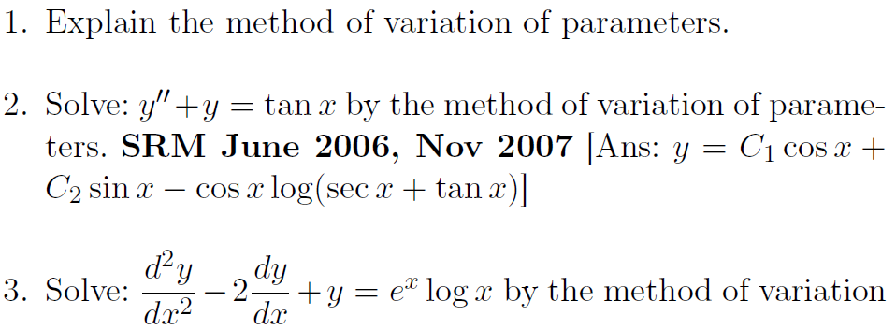

EXERCISE

